Slide 1
Rentals Database System
Data Management and Database Design
Team: Data Warriors
Nidhi Badde (001344844)
Snehal Zagade (001302530)
Prathamesh Zurale (001873937)
Keval Vankudre (001306921)

Slide 2
Contents
Summary
Final ERD
Implementation
Database Objects
Wireframes and Reports

Slide 3
Summary
Users
Products
Posts
Invoice
Orders

Slide 4
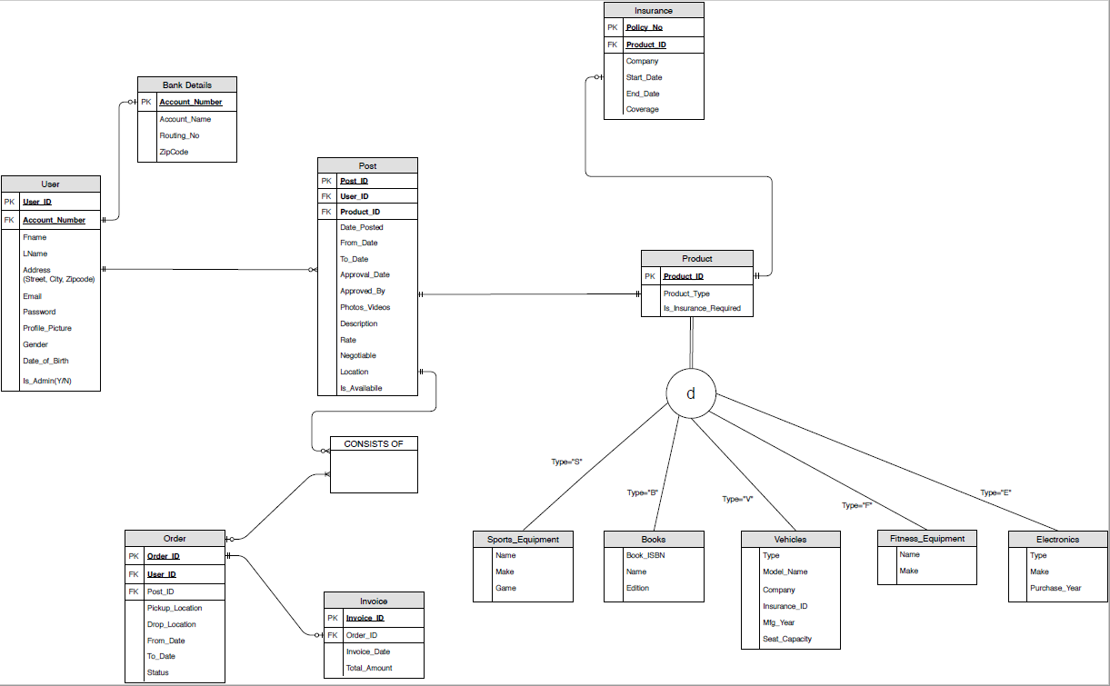
Entity Relationship Diagram
1

Slide 5
Database Tables
User Table
Product Table
create table [USER] (
[USER_ID] varchar(20) NOT NULL,
ACCOUNT_NO bigint NOT NULL ,
FNAME varchar (20),
LNAME varchar (20),
[ADDRESS] varchar(30),
EMAIL varchar (15),
[PASSWORD] varchar (10),
PROFILE_PICTURE image ,
GENDER varchar(6),
DATE_OF_BIRTH date,
CONTACT_NO numeric(10,0),
CARD_NUMBER numeric(16,0),
IS_ADMIN bit ,
constraint USER_ID_PK PRIMARY KEY ([USER_ID]),
constraint ACCOUNT_NO_FK FOREIGN KEY(ACCOUNT_NO) REFERENCES [BANK_DETAILS](ACCOUNT_NO)
);
ALTER TABLE [USER]
ALTER COLUMN IS_ADMIN char(3);
CREATE TABLE Product (
Product_ID varchar(20) PRIMARY KEY,
Product_Type char(1),
Is_Insurance_Required char(3));
alter table [dbo].[Product] with check add constraint [constraint_prodtype] check (([Product_Type] = 'S'
OR [Product_Type] = 'B' OR [Product_Type] = 'V' OR [Product_Type] = 'F' OR [Product_Type] = 'E'));
ALTER TABLE [dbo].[Product] CHECK CONSTRAINT [constraint_prodtype]
GO

Slide 6
Database Tables
Order Table
CREATE TABLE [Order] (
Order_ID VARCHAR(20) NOT NULL,
User_ID VARCHAR(20) NOT NULL,
Post_ID VARCHAR(20) NOT NULL,
Pickup_Location VARCHAR(40),
Drop_Location VARCHAR(40),
From_Date DATE ,
To_Date DATE,
Order_Status varchar(20)
PRIMARY KEY (Order_ID, Post_ID),
FOREIGN KEY (User_ID) REFERENCES [User](User_ID),
FOREIGN KEY (Post_ID) REFERENCES [Post](Post_ID),
);
Post Table
CREATE TABLE [Post] (
Post_ID VARCHAR(20) NOT NULL PRIMARY KEY,
User_ID VARCHAR(20) NOT NULL,
Product_ID VARCHAR(20) NOT NULL,
Date_Posted DATE,
From_Date DATE,
To_Date DATE,
Approval_Date DATE,
Approved_By VARCHAR(20) ,
Photos_Videos varchar(50),
[Description] VARCHAR(40),
Rate VARCHAR(20),
Negotiable char(3),
[Location] VARCHAR(40),
Is_Available char(3),
FOREIGN KEY (User_ID) REFERENCES [User](User_ID),
FOREIGN KEY (Product_ID) REFERENCES Product(Product_ID),
);

Slide 7
Database Tables
Bank Details Table
create table [BANK_DETAILS] (
​
ACCOUNT_NO bigint NOT NULL ,
ACCOUNT_USER_NAME varchar(30) ,
ROUTING_NO int ,
ZIP_CODE int,​
constraint ACCOUNT_NO_PK PRIMARY KEY (ACCOUNT_NO));
Invoice Table
CREATE TABLE "Invoice" (
Invoice_ID VARCHAR(20) NOT NULL PRIMARY KEY,
Order_ID VARCHAR(20) NOT NULL,
Invoice_Date DATE,
Total_Amount int ,
);
Insurance Table
CREATE TABLE Insurance(
Policy_No varchar(20) Primary Key,
Product_ID varchar(20),
Company varchar(30),
[Start_Date] varchar(12),
[End_Date] varchar(12),
Coverage int
FOREIGN KEY (Product_ID) REFERENCES Product(Product_ID));

Slide 8
Check Constraints
DOB and Gender
Product Type
------------DOB (USER)------------------
ALTER TABLE [dbo].[USER] WITH CHECK ADD CONSTRAINT [constraint_dob] CHECK (([DATE_OF_BIRTH]>='1900-01-01'
AND [DATE_OF_BIRTH]<='2019-11-19'))
GO
ALTER TABLE [dbo].[USER] CHECK CONSTRAINT [constraint_dob]
GO
----------- GENDER (USER)---------------
ALTER TABLE [dbo].[USER] WITH CHECK ADD CONSTRAINT [constraint_gender] CHECK (([GENDER] = 'Female' OR [GENDER] = 'Male')) ;
GO
ALTER TABLE [dbo].[USER] CHECK CONSTRAINT [constraint_gender]
GO
alter table [dbo].[Product] with check add constraint [constraint_prodtype] check (([Product_Type] = 'S'
OR [Product_Type] = 'B' OR [Product_Type] = 'V' OR [Product_Type] = 'F' OR [Product_Type] = 'E'));
ALTER TABLE [dbo].[Product] CHECK CONSTRAINT [constraint_prodtype]
GO

Slide 9
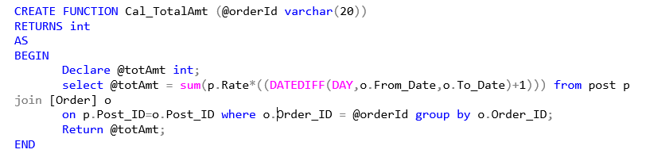
User Defined Functions
Function to Calculate
Total Amount in Order

Slide 10
Triggers
Invoice Total Amount Trigger
CREATE TABLE "Invoice" (
Invoice_ID VARCHAR(20) NOT NULL PRIMARY KEY,
Order_ID VARCHAR(20) NOT NULL,
Invoice_Date DATE,
Total_Amount int ,
);
CREATE TRIGGER Invoice_amt ON Invoice
for INSERT
AS
BEGIN
Declare @TotAmt int;
declare @oid varchar(20);
Select @oid = [Order_ID] from inserted invoice;
EXEC @TotAmt = Cal_TotalAmt
@orderId = @oid;
Update invoice set Total_Amount= @TotAmt where invoice_id = (select invoice_id from inserted invoice);
END

Slide 11
Triggers
Update Post Status Trigger
CREATE TABLE [Order] (
Order_ID VARCHAR(20) NOT NULL,
User_ID VARCHAR(20) NOT NULL,
Post_ID VARCHAR(20) NOT NULL,
Pickup_Location VARCHAR(40),
Drop_Location VARCHAR(40),
From_Date DATE ,
To_Date DATE,
Order_Status varchar(20)
PRIMARY KEY (Order_ID, Post_ID),
FOREIGN KEY (User_ID) REFERENCES [User](User_ID),
FOREIGN KEY (Post_ID) REFERENCES [Post](Post_ID),
);
CREATE TRIGGER Update_Post_Status
ON [Order]
for INSERT
AS
BEGIN
Declare @pid varchar(20);
Select @pid = [Post_ID] from inserted [Order];
Update Post set Is_Available='No' where Post_ID = @pid;
END;

Slide 12
Stored Procedures
Order history for a user
CREATE PROCEDURE Order_History @user_id varchar(20)
AS
BEGIN
Select * from [Order] where User_ID = @user_id;
END
Post history for a User
CREATE PROCEDURE Post_History @user_id varchar(20)
AS
BEGIN
Select * from Post where User_ID = @user_id;
END

Slide 13
Stored Procedures
Post and Order history of all User
CREATE PROCEDURE All_User
As
BEGIN
Select Distinct p.USER_ID, p.POST_ID AS POSTED_POSTS from Post p order by p.user_id, p.post_id;
Select DISTINCT o.USER_ID, o.ORDER_ID AS ORDER_NOS, o.post_id AS ORDERED_POST
from [order] o order by o.user_id, o.order_id;
END;

Slide 14
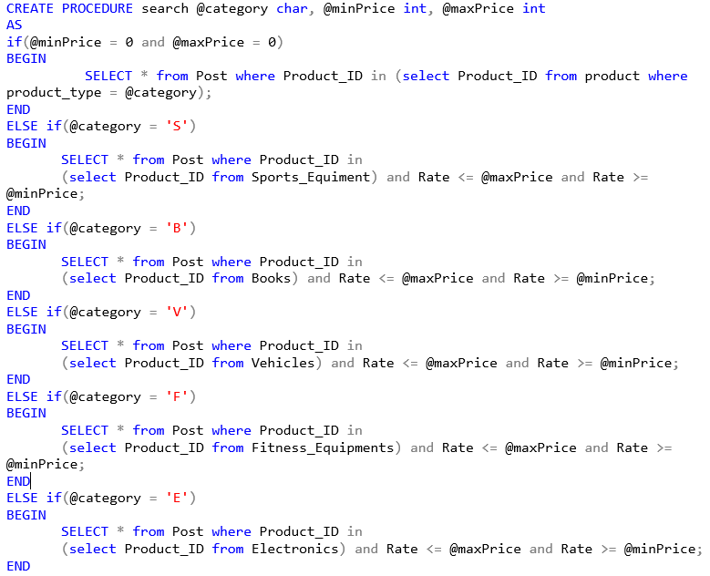
Stored Procedures
Search using category and price filters

Slide 15
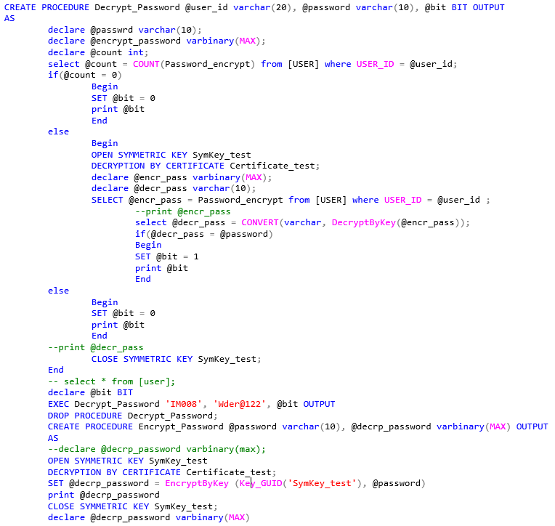
Stored Procedures
Password Encryption (AES_256)

Slide 16
Views
Availability for 10+ days
Most rented Products
CREATE VIEW Pro_Avl_More_Than_10_Days
AS
select d.Product_ID, d.Product_Type, p.Post_ID, p.From_Date, p.To_Date,p.Photos_Videos, p.Description, p.Rate, p.Location
from product d join post p on p.Product_ID = d.Product_ID where
(DATEDIFF(dd, p.From_Date, p.To_Date)+1)>=10 and p.Is_Available like 'Yes' ;
CREATE VIEW Top_3_Post
AS
select TOP 3 o.Post_ID, count(*) AS Sold_No_Of_Times from [Order] o
where o.Post_ID in
(select p.Post_ID from post p)
group by o.Post_ID order by Sold_No_Of_Times desc;
Unapproved posts
CREATE VIEW UnApproved_Posts
AS
Select * from [Post] p
where
p.approved_by is null;

Slide 17
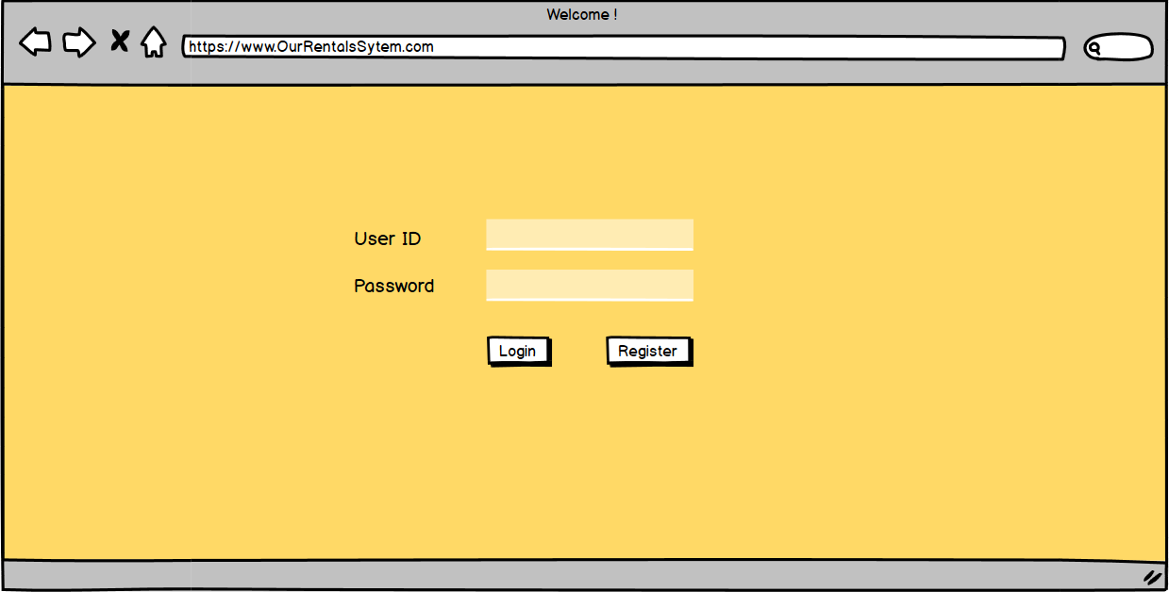
Wireframes

Slide 18
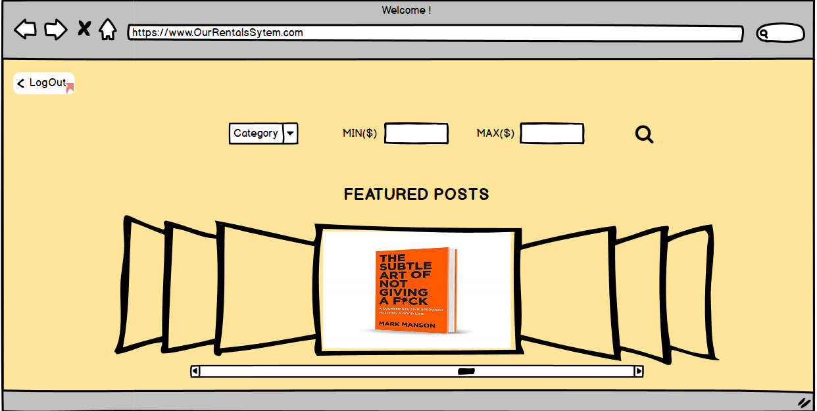
Wireframes

Slide 19
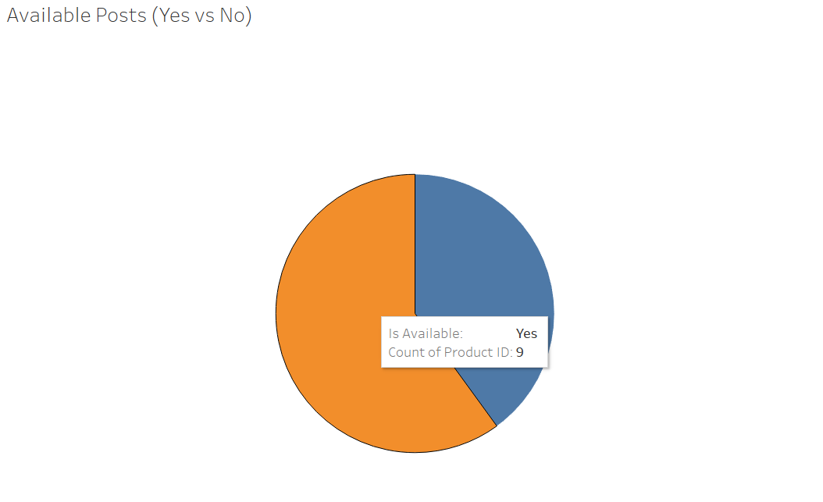
Reports
Fig: A Pie-Chart depicting number of posts Available vs Not Available (Built in Tableau)

Slide 20
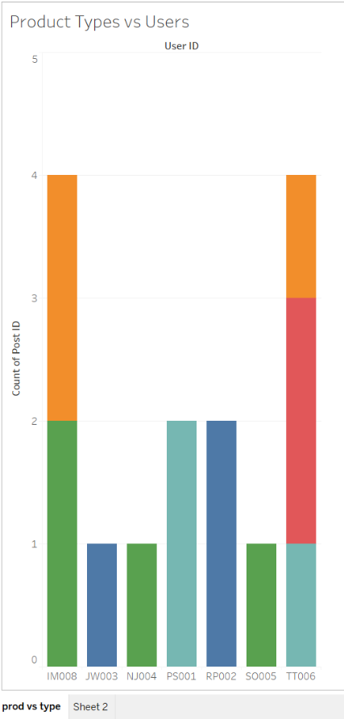
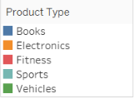
Reports
Fig: Bar Graph depicting Count of posts per user and further categorized by Product type

Slide 21
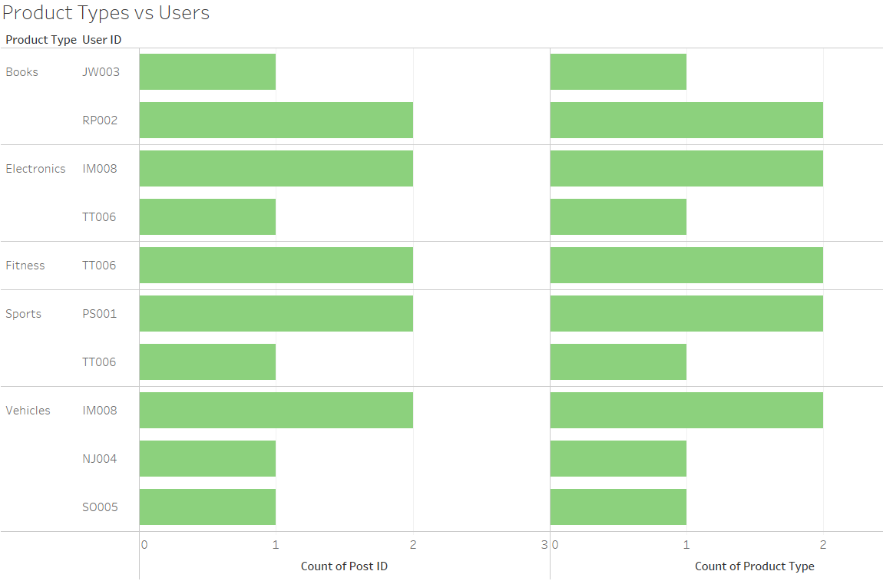
Reports
Fig: Graph depicting Posts categorized by Product types

Slide 22
Thank You !
Stay Home, Stay Safe.

